Slide 1
Hiccups in Pringle Stack and Licorice Rope Meshing Methods
Caleb B. Goates, Kendrick M. Shepherd
Brigham Young University
Supported by NSF grant 2245491

Slide 2
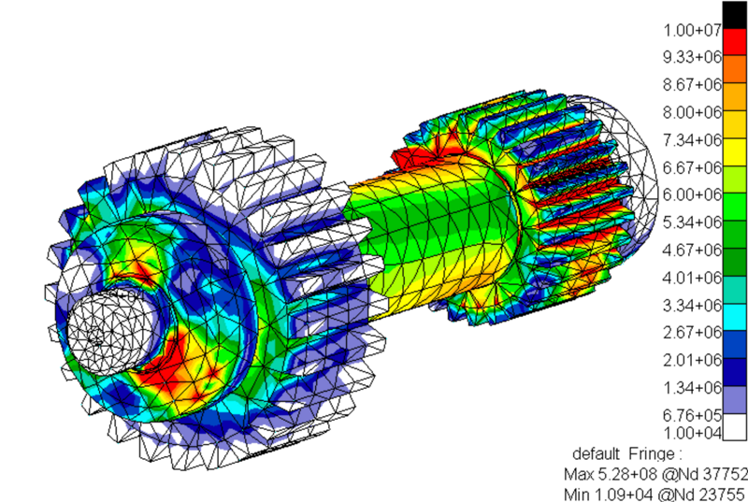
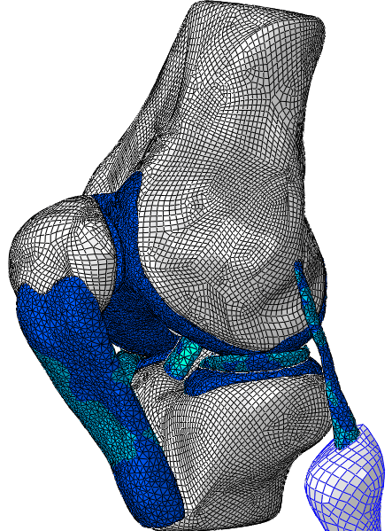
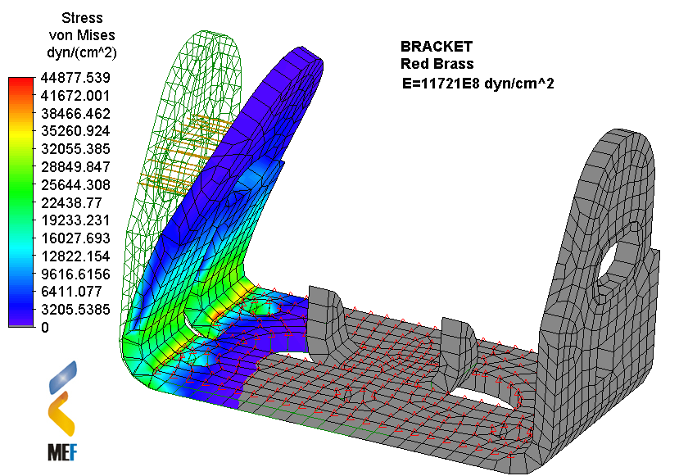
Meshing
Necessary for computational analysis
Hex/quad > tet/triangle
Hex meshing is typically very time consuming
(Semi)automatic guaranteed valid meshes are the holy grail
wikimedia.org/wiki/File:Gears_and_shaft_FEA_MSC_Nastran.png
wikimedia.org/wiki/File:Human_knee_joint_FE_model.png
wikimedia.org/wiki/File:Bracke2.png

Slide 3
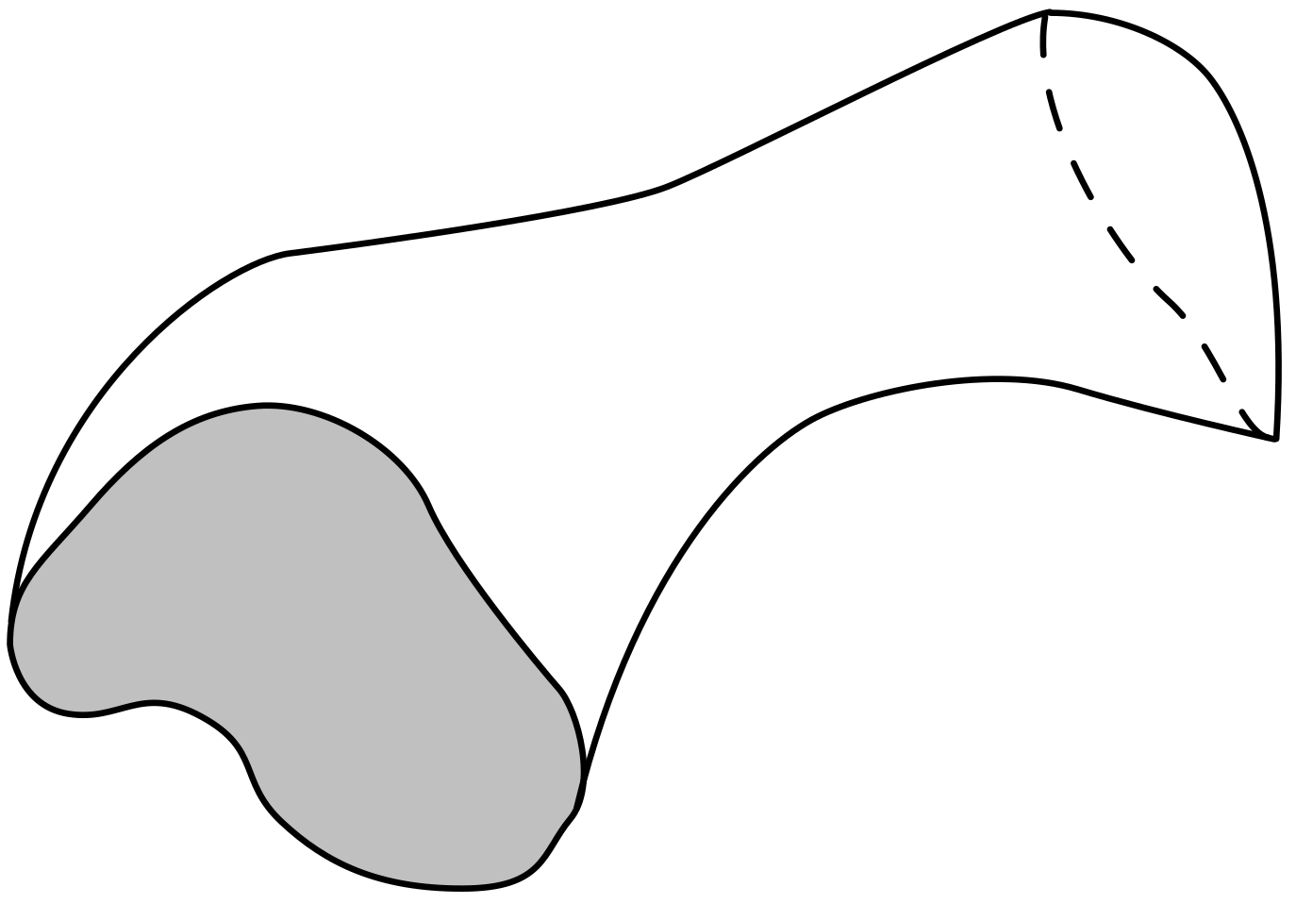

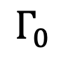
Sweeps
$$Γ_{1}$$
$$Γ_{0}$$

Slide 4
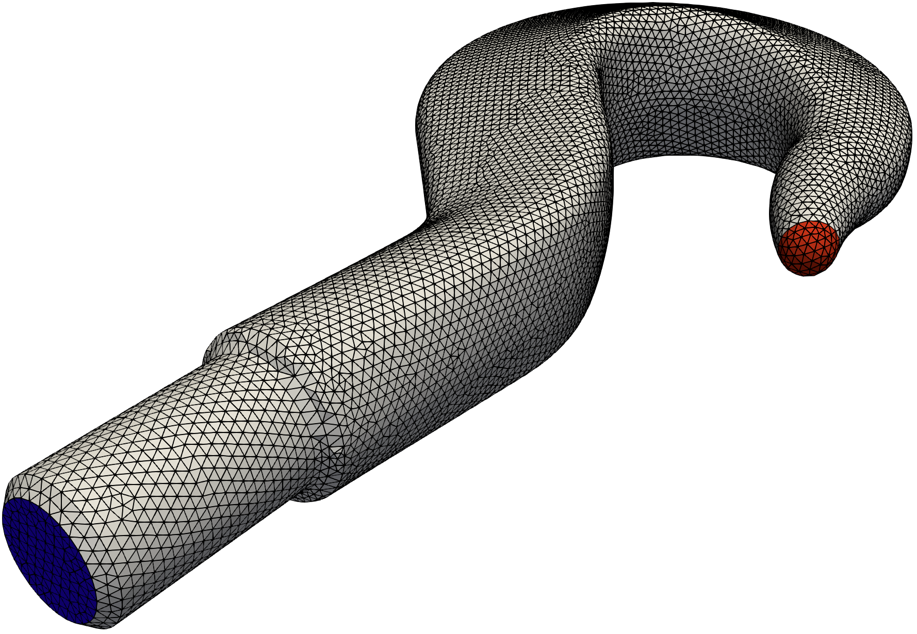
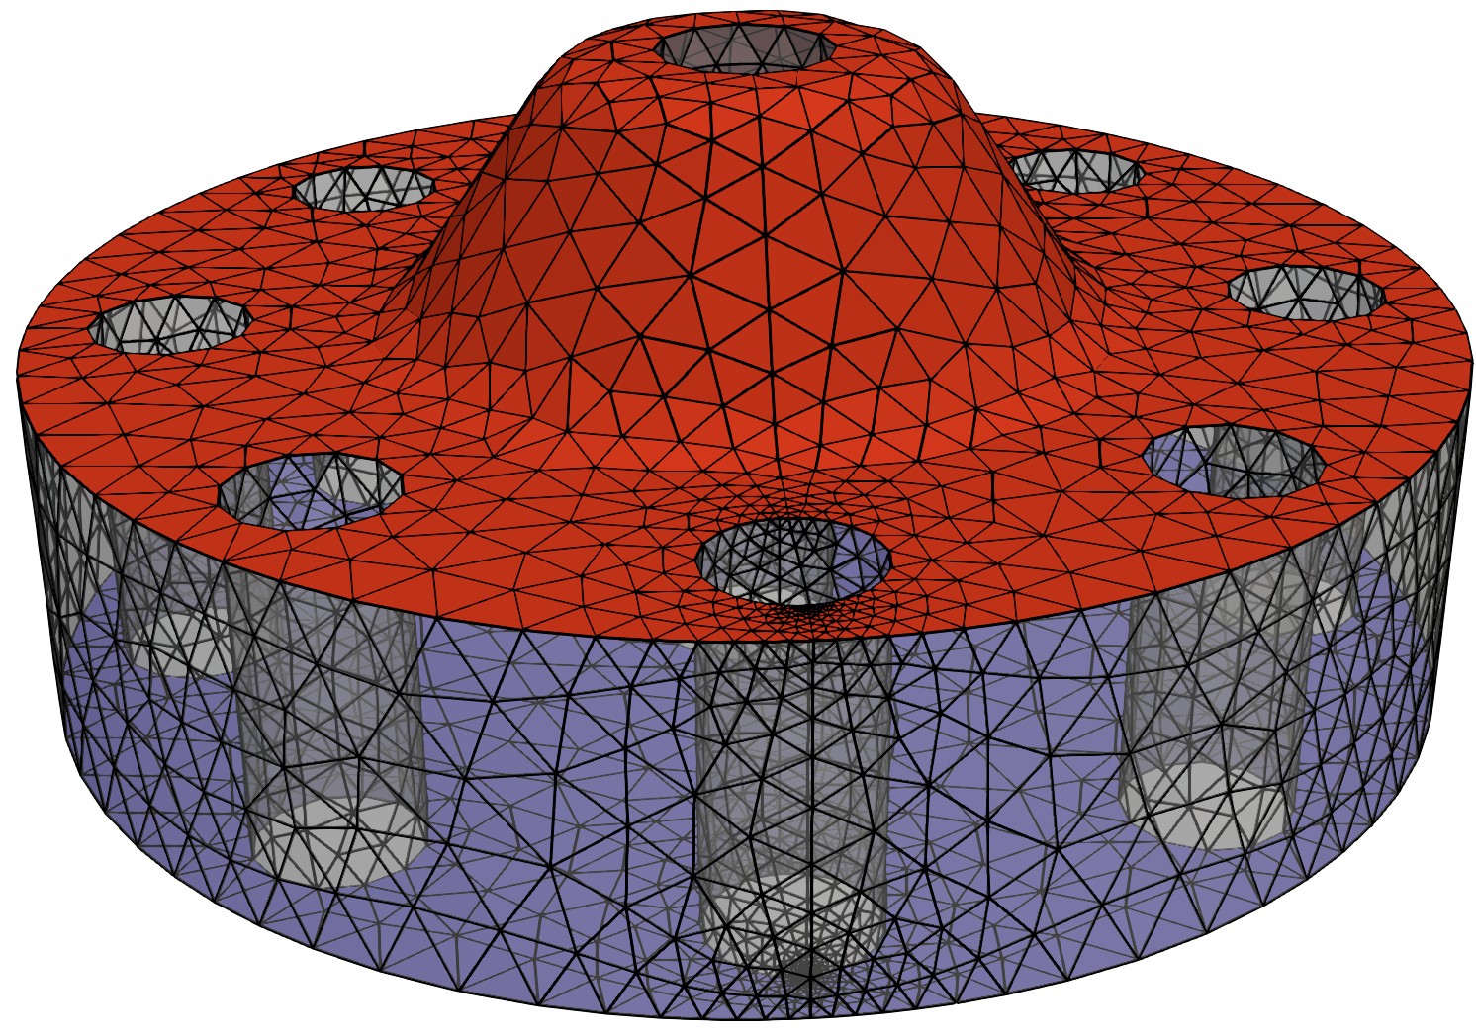
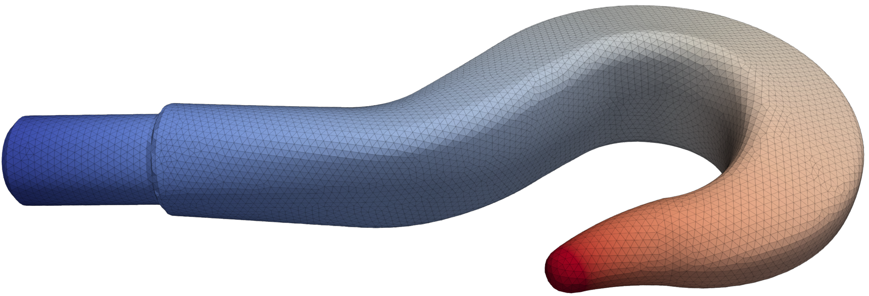
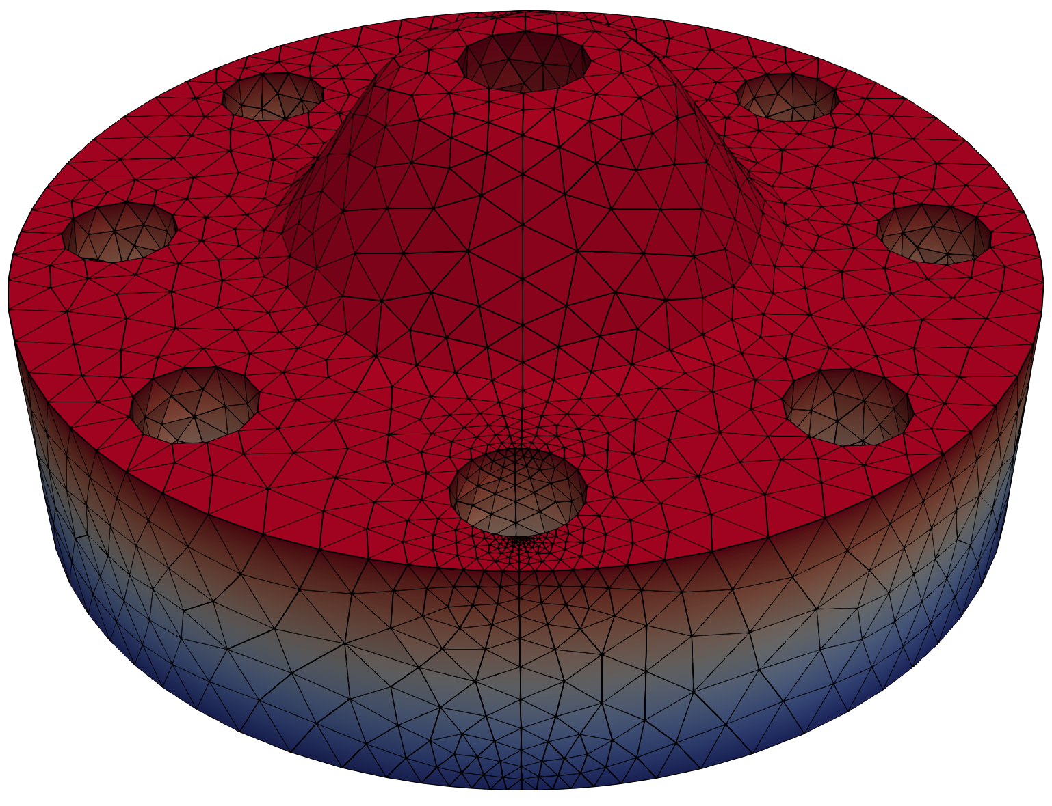
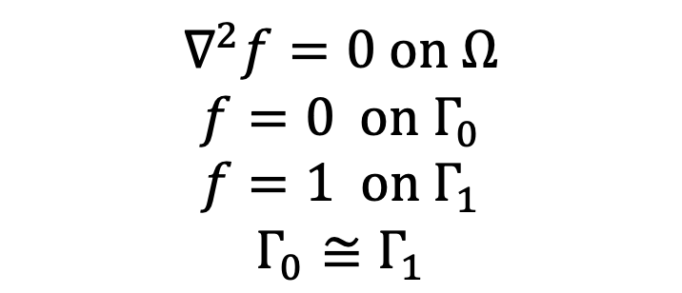
Sweep Harmonic Function
$∇^{2}f=0 on Ω$
$$f=0 on Γ_{0}$$
$$f=1 on Γ_{1}$$
$$Γ_{0}≅Γ_{1}$$
Notes:
EXPLAIN HOW THIS IS USED TO DEFINE THE THIRD COORDINATE

Slide 5
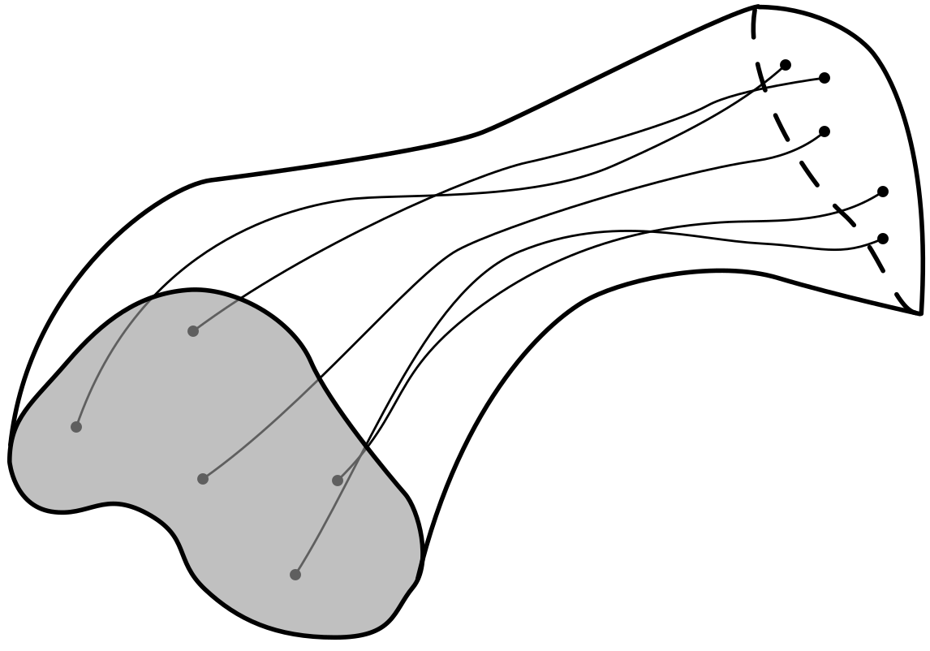
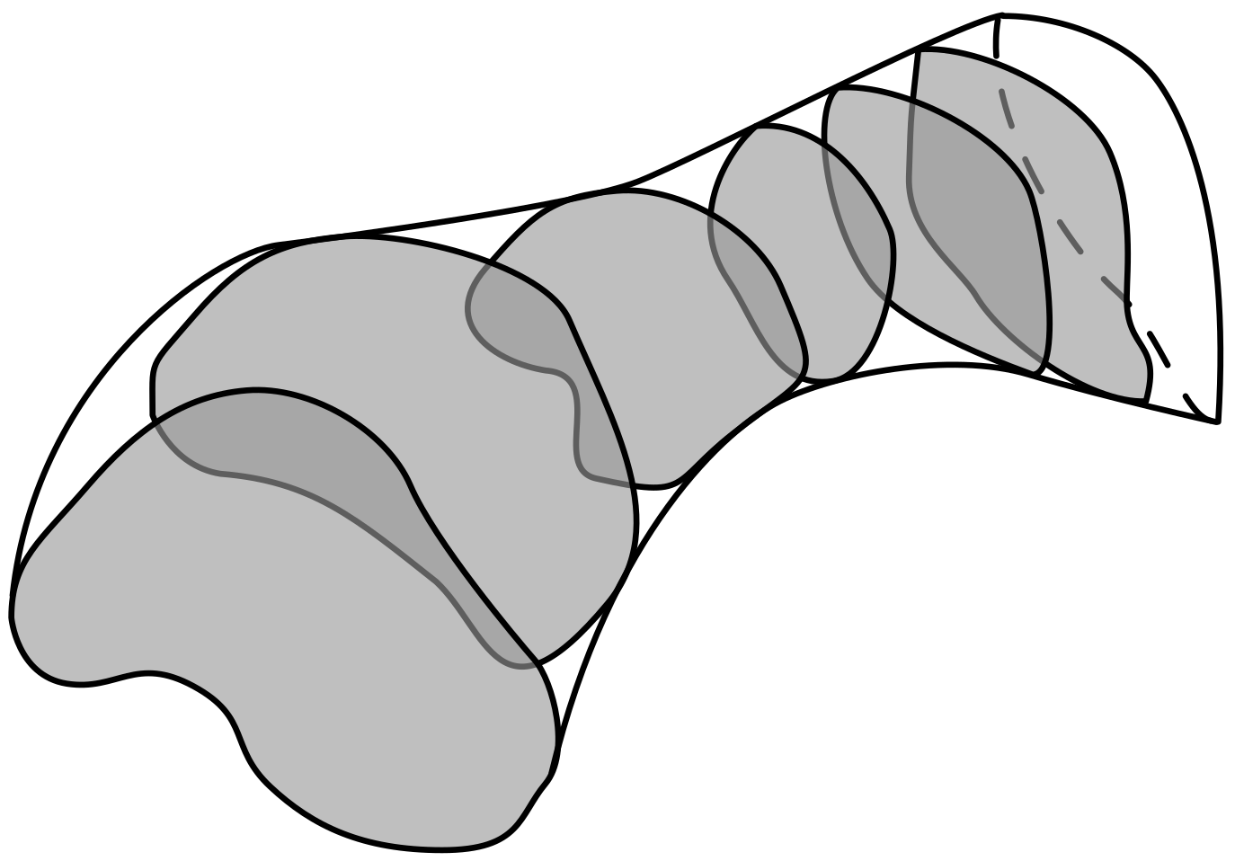
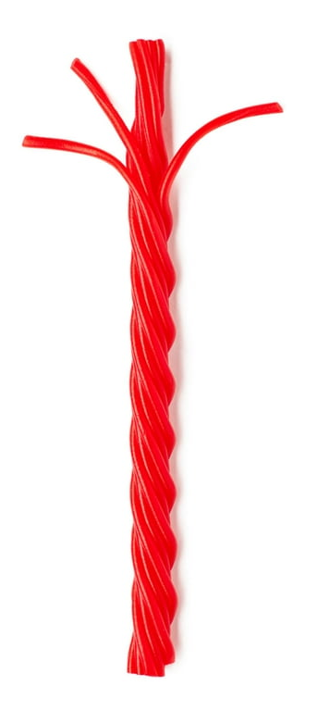
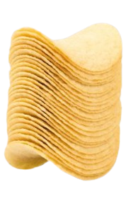
Sweep Meshing

Slide 6
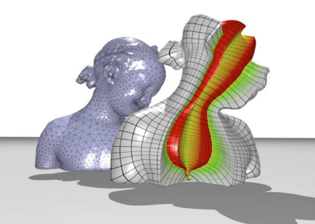
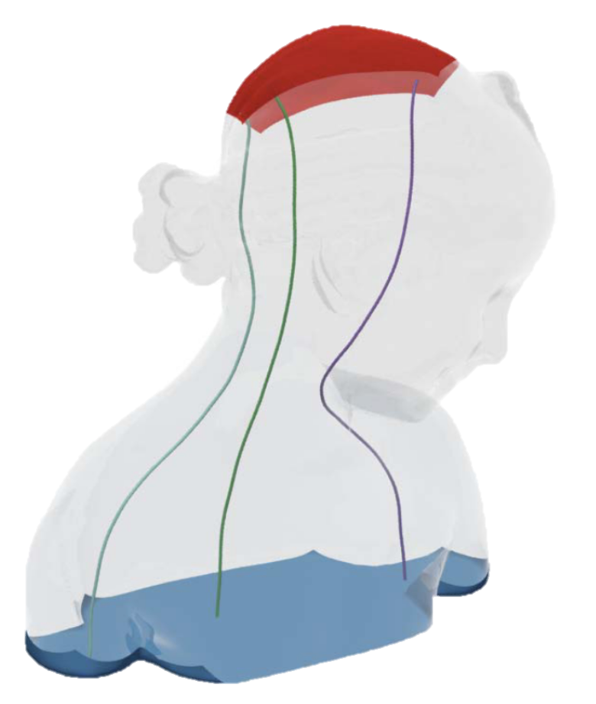
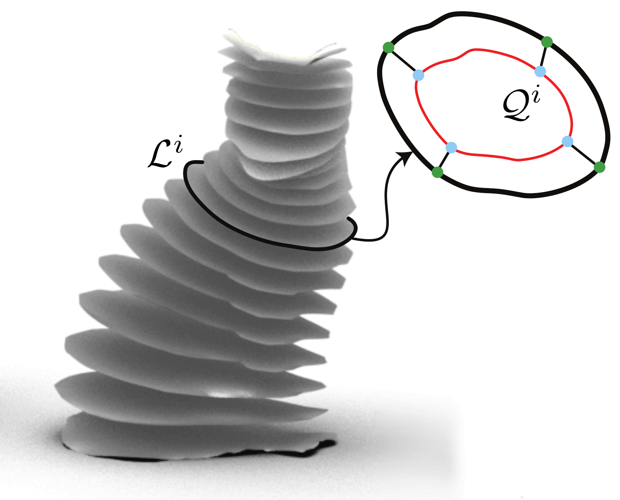
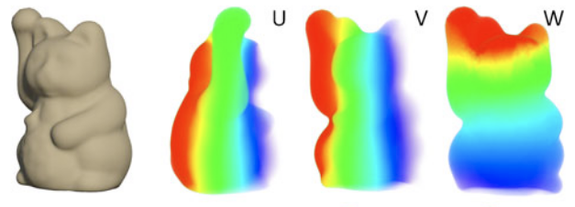
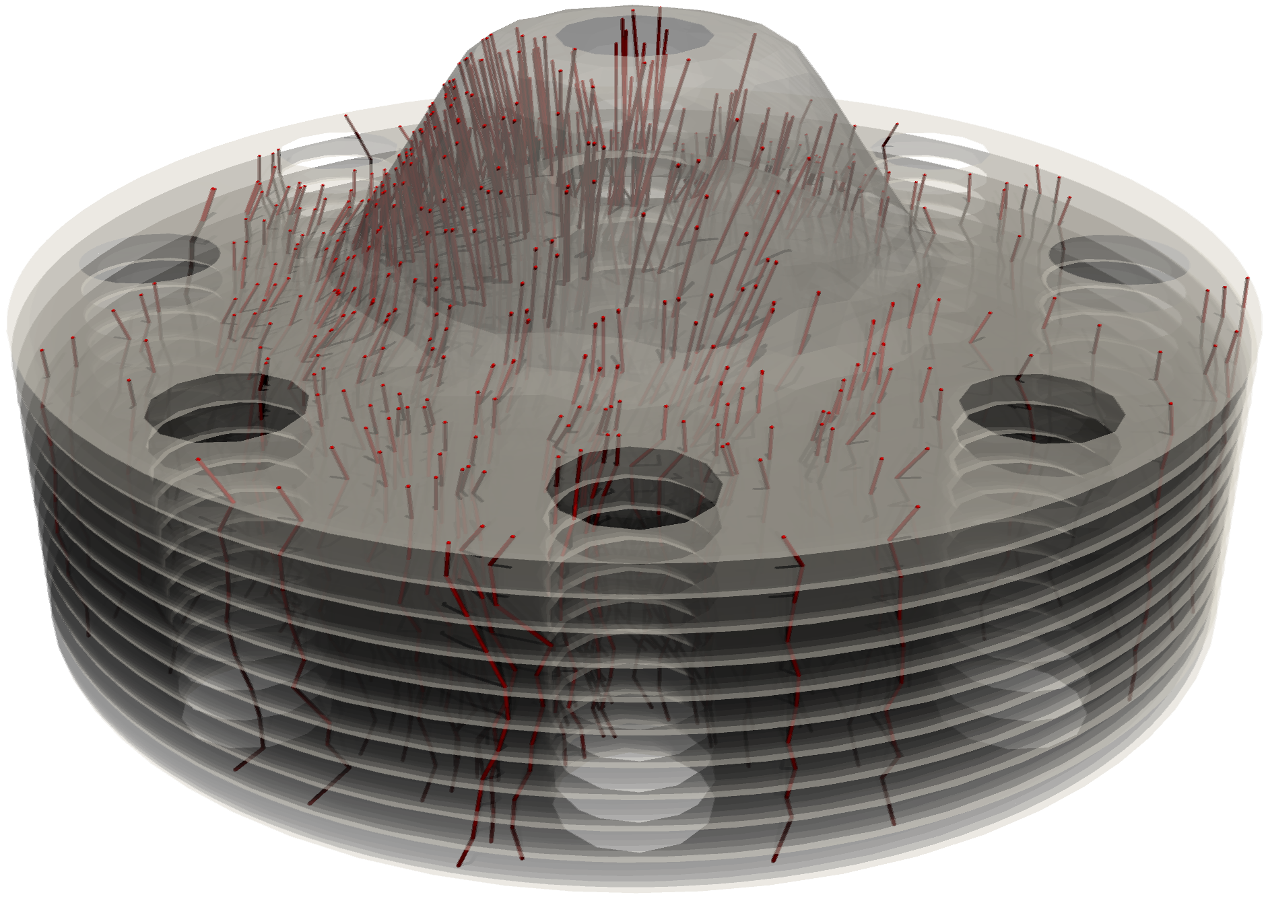
Sweep harmonic functions for meshing
PROOF
Martin 2008
Xia 2010
Lin 2015
Goates 2025
Gao 2015
Notes:
MOVE THROUGH THIS QUICKLY
Martin and collaborators, including Elain Cohen (sitting over there?) traced the gradient of multiple laplace functions to generate a cylindrical parameterization on cylinder-like objects.
Xia (Zhia) and collaborators, including David Gu, who is sitting over here, used a volumetric laplace function with source and target surfaces and traced its gradient to create a foliation of 1d leaves and a parameterization. Their work applied to handlebodies as well as cylindrical objects.
These laplace function gradient tracing methods share a downside that for a discrete harmonic function there may be converging vectors on a triangle or edge where tracing must be continued using some heuristic.
Campen and collaborators addressed this in 2016 by showing that for a certain class of meshes, called “bishellable” meshes, you can algorithmically construct a vector field to trace that doesn’t exhibit these converging vectors. Their work only addressed the geometries that are a topological ball, i.e. no handlebodies, or no holes in the object.
SKIP Wang and collaborators also used a surface laplace function on the boundary of the geometry to create a polycube parameterization to which they fit T-splines. CAN I REMOVE THIS? ODD DUCK OUT
Gao and collaborators, including Elain Cohen, also applied a 2d foliation to this problem, by taking the level sets of a volumetric harmonic function, and connecting templates on each level set. Their method included a special handling of bifurcations, where the level sets split into two separate regions. This technique does not treat geometries in which the level sets have holes in them, but through the bifurcation technique can treat handlebodies if the sweep direction is chosen appropriately.
There are others, but these are the main

Slide 7
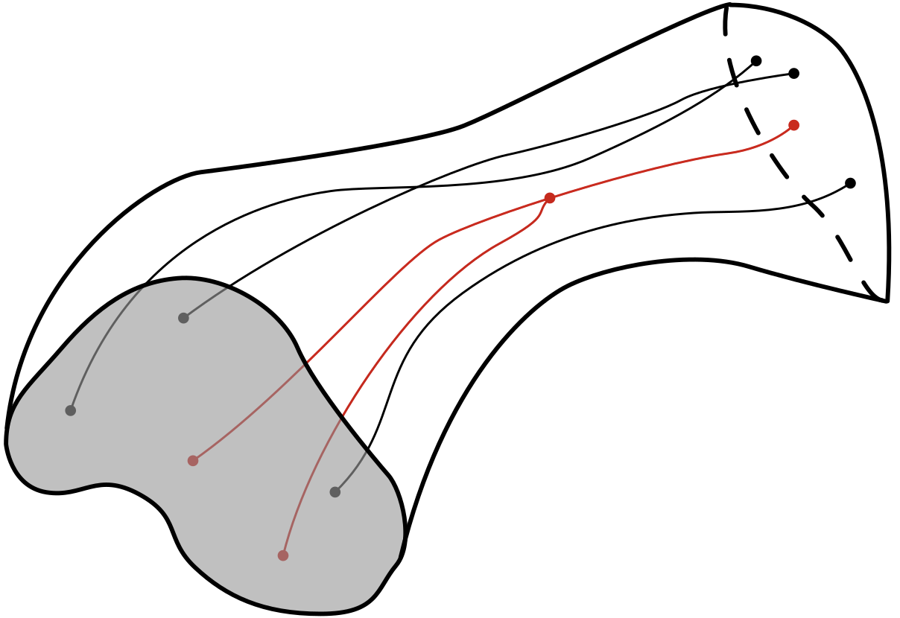
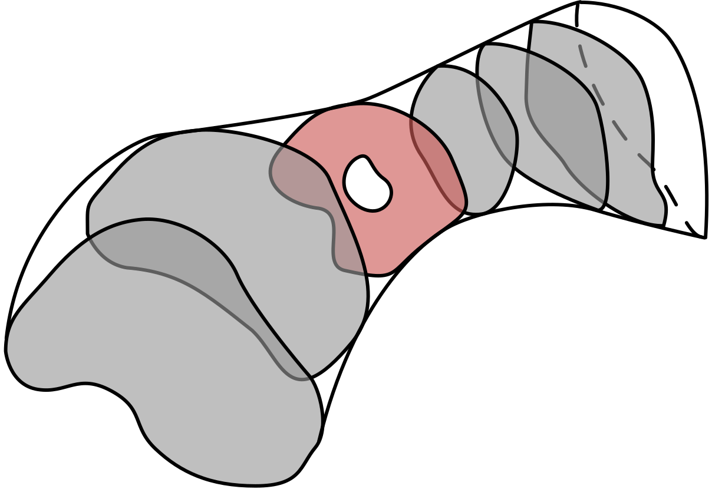
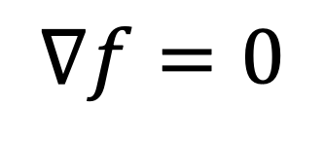
Requirements for proof
PROOF
$$∇f=0$$
Xia 2010
Lin 2015
Notes:
Mention Morse theory here

Slide 8
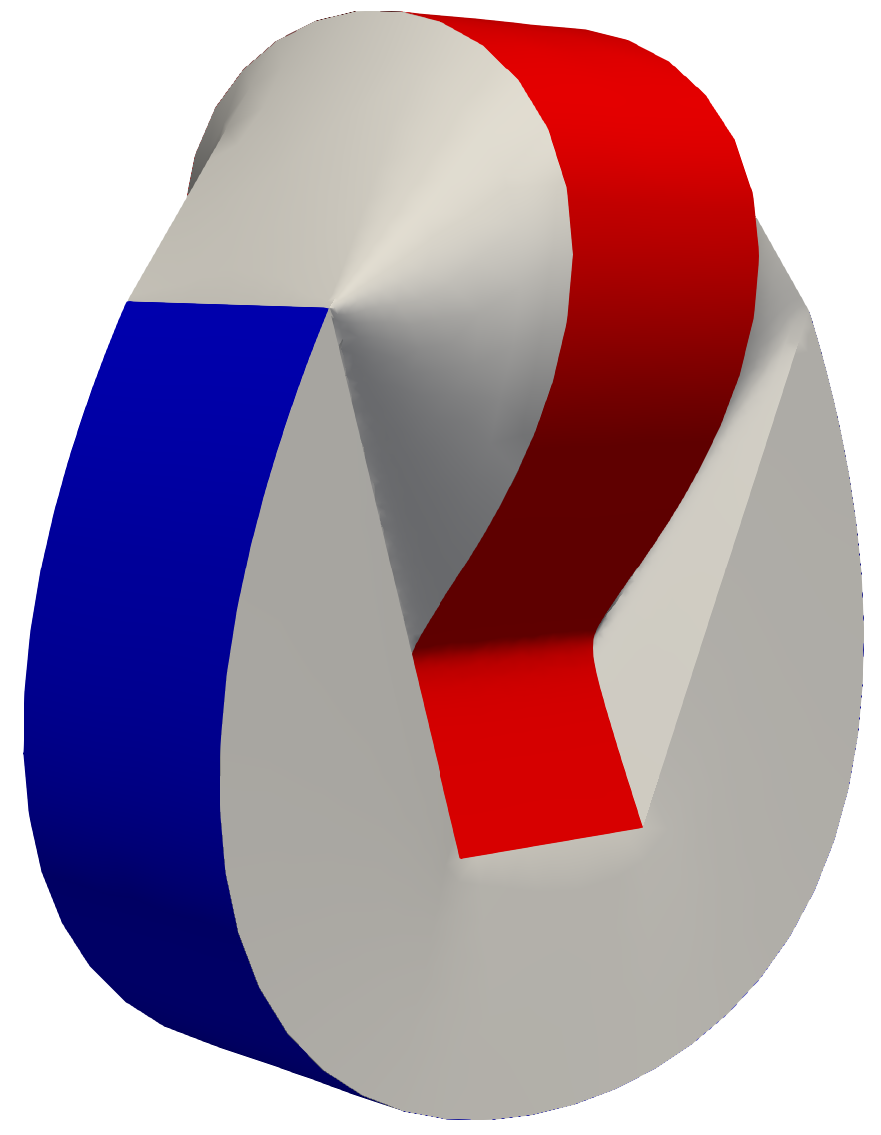

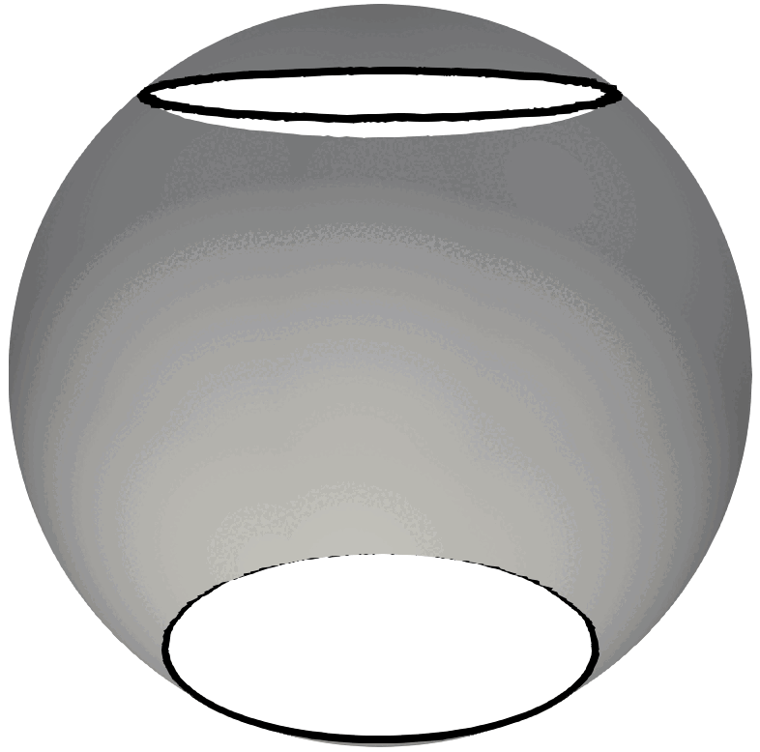
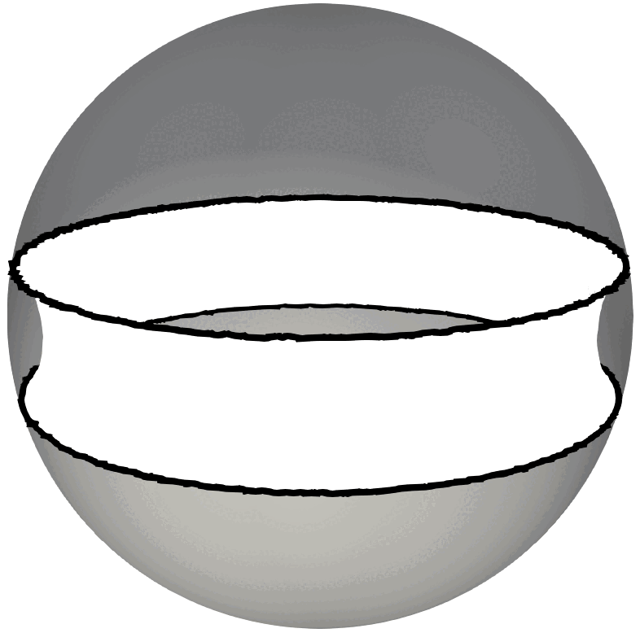
Counterexample

Slide 9
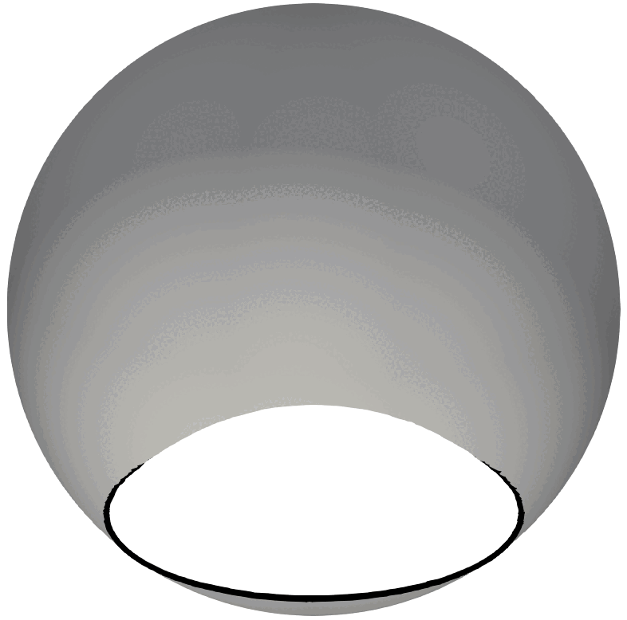
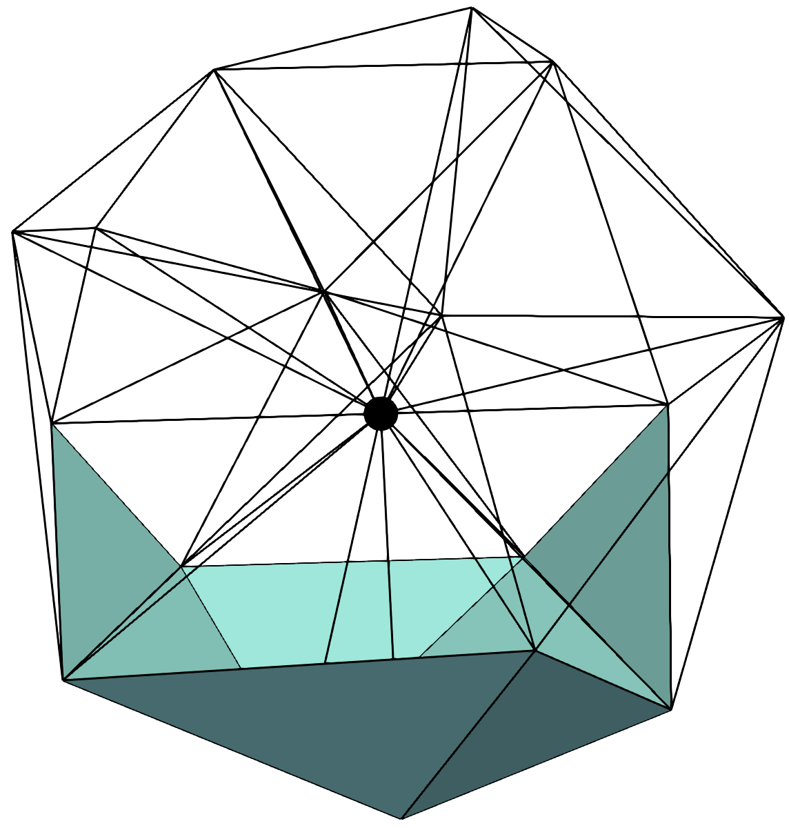
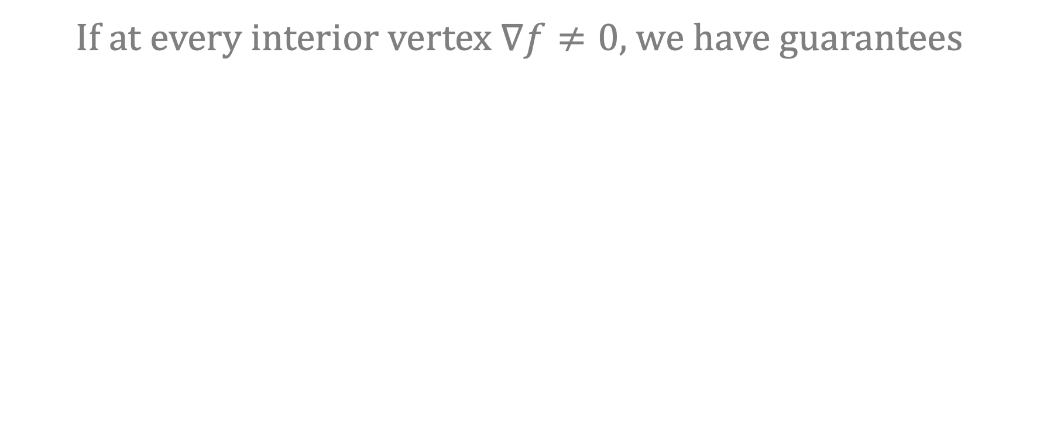

Checking for $∇f=0$
If at every interior vertex $∇f≠0$, we have guarantees

Slide 10
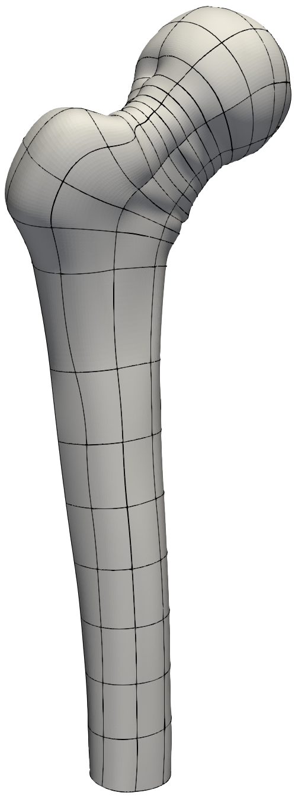
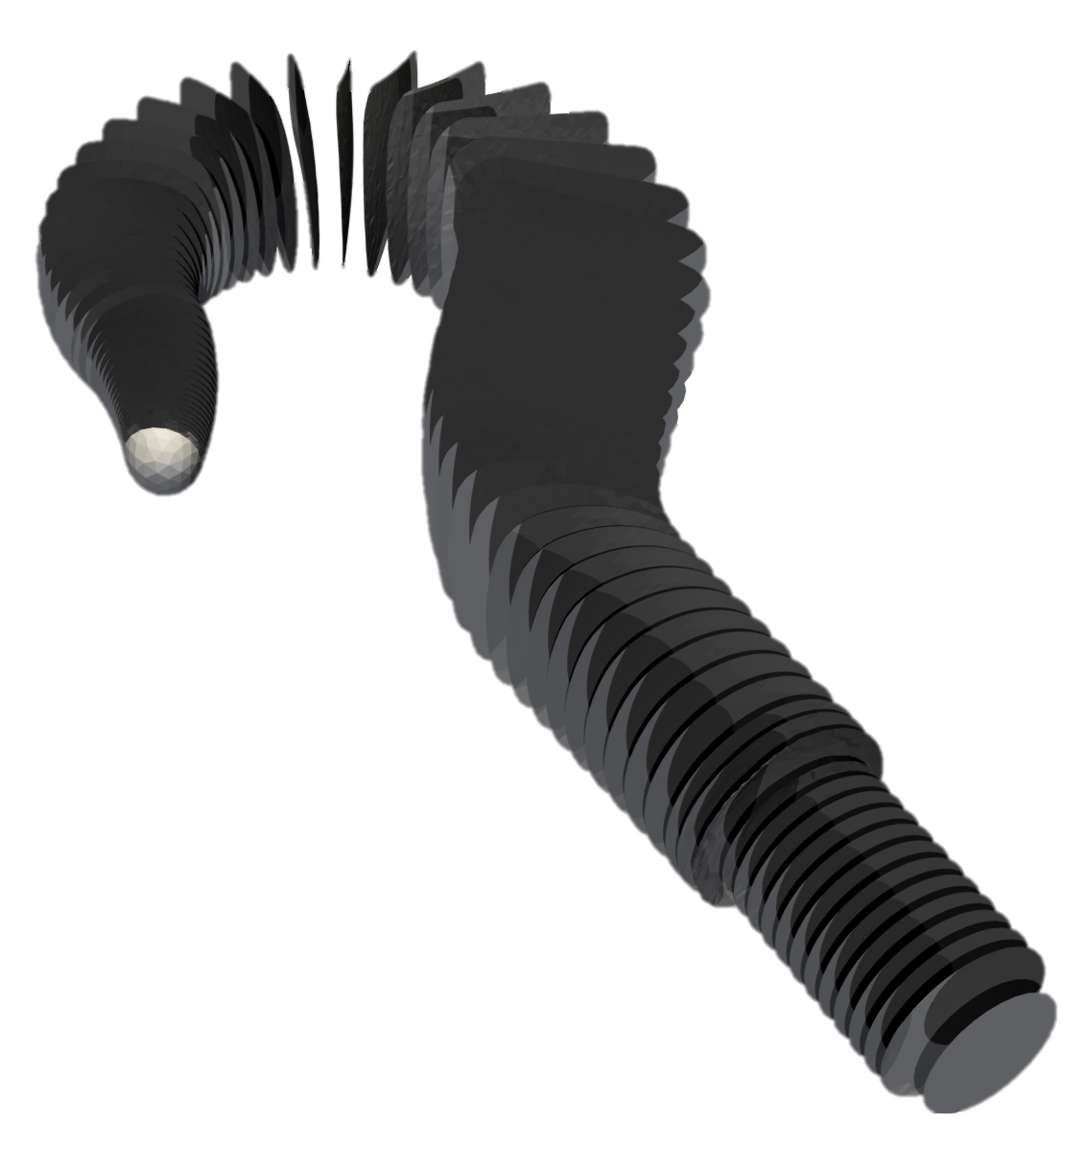
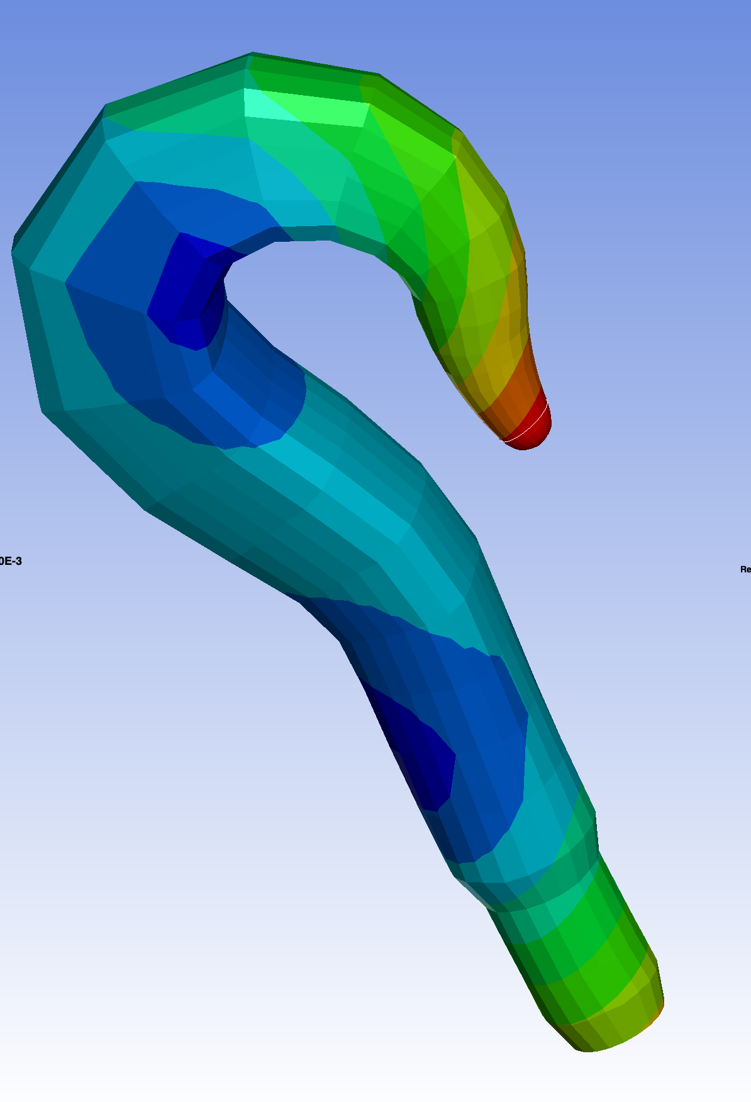
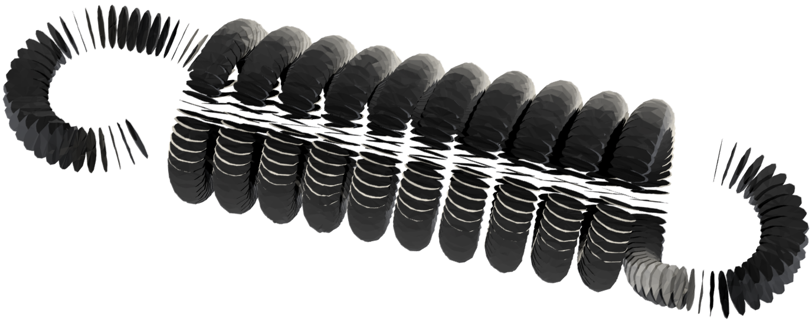
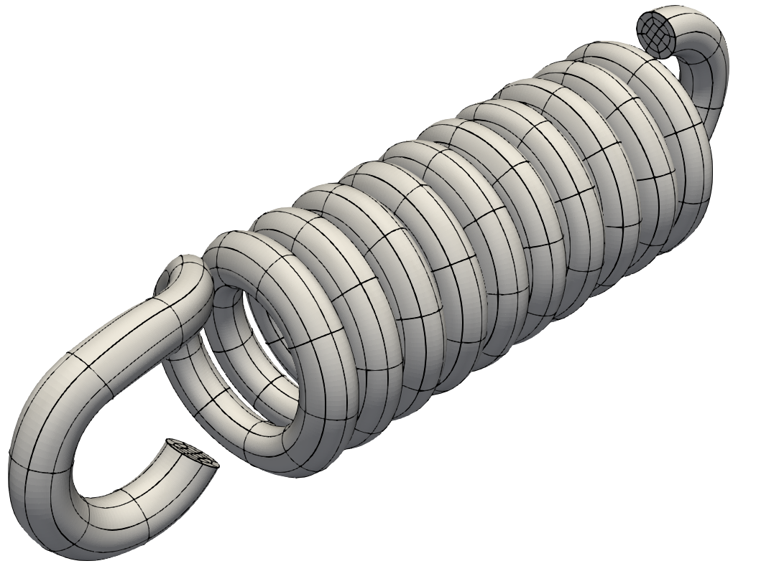
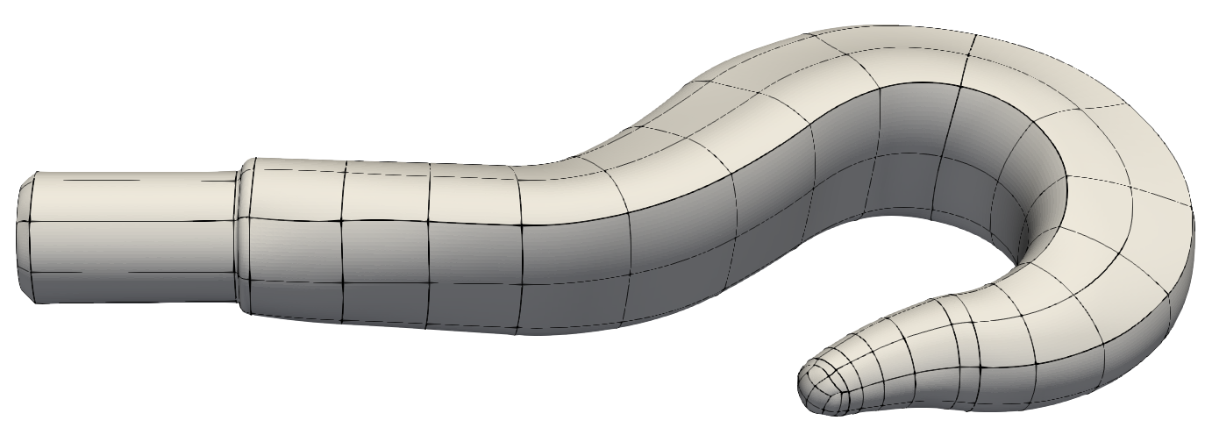
Level-set-based method

Slide 11
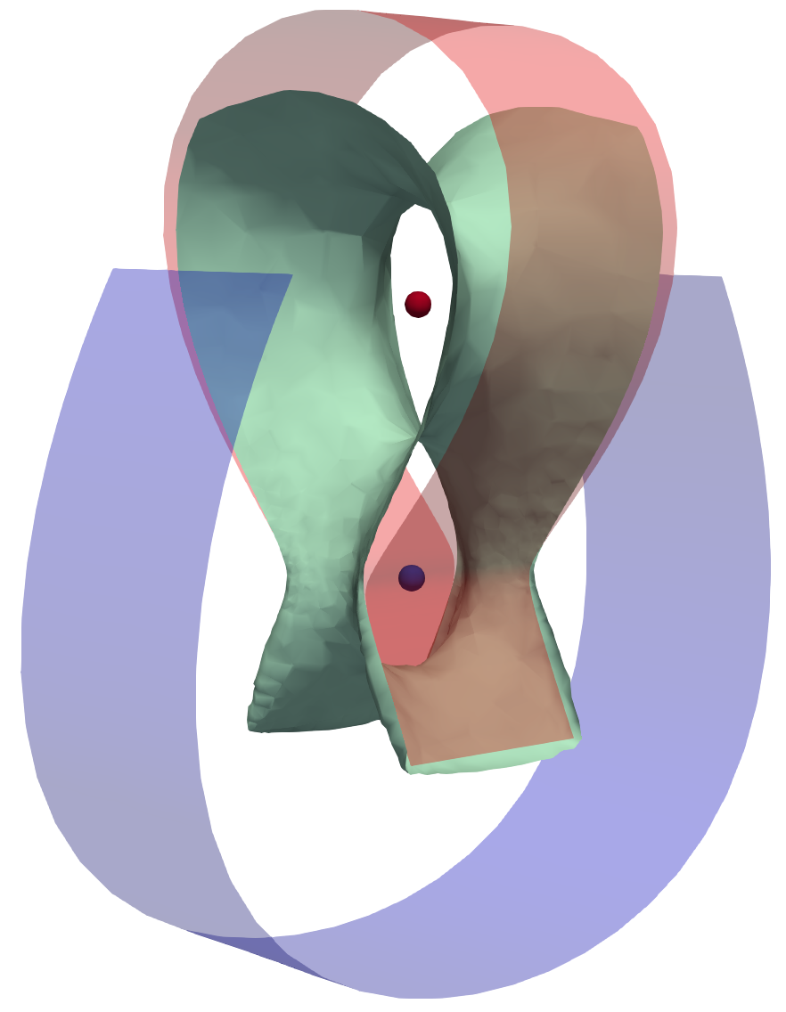
Conclusions
Sweep meshing method isn’t guaranteed to work
We constructed a counterexample to proofs that said it was
There is a simple parallelizable test to tell if it will work in each case
https://arxiv.org/abs/2503.01573

